Slide 1
Discrete Mathematics and Its Application
7th edition, 2001
Kenneth H. Rosen

Slide 2
Welcome to
Discrete Mathematics
Spring 2018
Instructor: Niu Shao Zhang

Slide 3
1.4 Predicates and Quantifiers
p: Beijing is a big city
q: Shanghai is a big city also
p 和 q 没有联系
College of Computer Science & Technology, BUPT

Slide 4
Predicates and Quantifiers
A generalization of propositions - propositional functions (命题函数) or predicates (谓词): propositions which contain variables
Predicates become propositions once every variable is bound by
  assigning it a value or an object (个体) from the Universe of Discourse (论域) U
or
  quantifying it
College of Computer Science & Technology, BUPT

Slide 5
Formulas of predicate logic (informal)
We will use various kinds of individual constants that denote individuals/objects: a,b,c,…
Individual variables over objects: x, y, z , …
The result of applying a predicate P to a
constant a is the proposition P(a)
Meaning: the object denoted by a has the property denoted by P.
College of Computer Science & Technology, BUPT

Slide 6
Formulas of predicate logic (informal)
The result of applying a predicate P to a
variable x is the propositional form P(x).
  E.g. if P = “is a prime number”, then
  P(x) is the propositional form
  “x is a prime number.
College of Computer Science & Technology, BUPT
Notes:
Explain the notion of a propositional form

Slide 7
Examples
Let U = , the integers = {. . . -2, -1, 0 , 1, 2, . . .}
  P(x): x > 0
is the predicate. It has no truth value until the variable x is bound.
Examples of propositions where x is assigned a value:
  P(-3) is false,
  P(0) is false,
  P(3) is true.
The collection of integers for which P(x) is true are the positive integers.
College of Computer Science & Technology, BUPT

Slide 8
Examples
P(y)∨∼P(0) is not a proposition. The variable y has not been bound. However, P(3)∨∼P(0) is a proposition which is true.
College of Computer Science & Technology, BUPT

Slide 9
Propositional Functions
Topic #3 – Predicate Logic
Predicate logic generalizes the grammatical notion of a predicate to also include propositional functions of any number of arguments, each of which may take any grammatical role that a noun can take.
  E.g. let P(x,y,z) = “x gave y the grade z”, then if
  x=“Mike”, y=“Mary”, z=“A”, then P(x,y,z) = “Mike gave Mary the grade A.”
College of Computer Science & Technology, BUPT

Slide 10
N-place predicate（N元谓词 ）
A statement involving the n variables x₁, x₂ ,…x_{n} can be denoted by P(x₁, x₂ ,…x_{n} ).
A statement of the form P(x₁, x₂ ,…x_{n} ) is the value of the propositional function P at the n-tuple (x₁, x₂ ,…x_{n} ), and P is also called a n-place predicate or a n-ary predicate.
College of Computer Science & Technology, BUPT

Slide 11
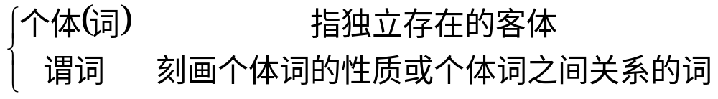
谓词逻辑的基本概念(复习)
简单命题分解成
李明是个大学生。 “李明”是个体词，“......是个大学生”是谓词。
张明与张亮是兄弟。“张明” “张亮”是个体词，“......与...... 是兄弟”是谓词。
北京邮电大学 计算机学院 离散数学

Slide 12

个体词
个体词：可以是具体的事物，也可以是抽象的概念
例如：人名，桌子，......，是具体的事物； ，思想，......，是抽象的概念。
北京邮电大学 计算机学院 离散数学

Slide 13
个体常项和个体变项
个体常项：表示具体的或特定的个体的词。
个体变项：表示抽象的或泛指的个体的词。
个体常项用小写英文字母 a, b, c, … 表示，
个体变项用小写英文字母 x, y, z, …表示。
北京邮电大学 计算机学院 离散数学

Slide 14
谓词
用大写的英文字母表示谓词 F, G, H, …, 如表示“…是大学生”。
谓词常项：表示具体性质或关系的谓词。
谓词变项：表示抽象或泛指的谓词。
北京邮电大学 计算机学院 离散数学

Slide 15
谓词
个体词 a 具有性质F，记为 F(a)。
个体词 x, y 具有性质 L，记为L(x, y) 。
北京邮电大学 计算机学院 离散数学

Slide 16
n元谓词
定义：在谓词中所包含的个体词数称为元数，含 n(n≥1) 个个体词的谓词称为 n 元谓词。
一元谓词表示个体词的性质。
n(n≥2)元谓词表示个体词之间的关系。
例如： F(x)表示x是个大学生， L(x, y) 表示 x 小于 y.
北京邮电大学 计算机学院 离散数学

Slide 17
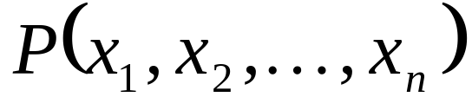
命题函数
定义：由一个谓词，一些个体变项组成的表达式称为简单命题函数（简称命题函数）。
为 n 元命题函数。
北京邮电大学 计算机学院 离散数学

Slide 18
Quantifiers – Universal(全称量词)
P(x) is true for every x in the universe of discourse.
Notation: universal quantifier
∀xP(x)
‘For all x, P(x)’, ‘For every x, P(x)’
The variable x is bound by the universal quantifier producing a proposition.
College of Computer Science & Technology, BUPT

Slide 19
Universal Quantification
Let P(x) be a propositional function.
Universally quantified sentence:
For all x in the universe of discourse P(x) is true.
Using the universal quantifier ∀:
∀x P(x) “for all x P(x)” or “for every x P(x)”
(Note: ∀x P(x) is either true or false, so it is a proposition, not a propositional function.)
Fall 2007
06B11,12,13 - Discrete Structures

Slide 20
Example 9
Let P(x) be the statement “x+1>x”. What is the truth value of the quantification ∀xP(x), where the universe of discourse consists of all real numbers?
D=R
Solution: Because “x+1>x” is true for all real numbers.
∀xP(x) is true.
College of Computer Science & Technology, BUPT

Slide 21
Example 10
Let P(x) be the statement “x²>0”. What is the truth value of the quantification ∀xP(x), where the universe of discourse consists of all integers?
Solution: Note that x=0 is an integer, but 0²=0.
So x² universe is not greater than 0 when x=0.
∀xP(x) is false.
College of Computer Science & Technology, BUPT

Slide 22
Quantifiers - Universal
Example:
U={1, 2, 3}
∀xP(x)⇔ P(1) ∧ P(2) ∧ P(3)
College of Computer Science & Technology, BUPT

Slide 23
Example 11
What is the truth value of ∀xP(x), where P(x) is the statement “x²<10” and the universe of discourse consists of the positive integers not exceeding 4?
Solution: The universe of discourse D={1,2,3,4},
∀xP(x)⇔ P(1) ∧ P(2) ∧ P(3) ∧ P(4)
=1 ∧ 1 ∧ 1 ∧ 0
=0
it follows that ∀xP(x) is false.
College of Computer Science & Technology, BUPT

Slide 24
Universal Quantification
Example:
S(x): x is a small pig.
G(x): x is a pig.
What does ∀x (S(x) → G(x)) mean ?
“If x is a small pig, then x is a pig.”
or
“All small pigs are pigs.”
Fall 2007
06B11,12,13 - Discrete Structures

Slide 25
Quantifiers – Existential(存在量词)
P(x) is true for some x in the universe of discourse.
Notation: existential quantifier
∃xP(x)
‘There is an x such that P(x)’, ‘For some x, P(x)’, ‘For at least one x, P(x)’, ‘I can find an x such that P(x).’
College of Computer Science & Technology, BUPT

Slide 26
Example 14
Let P(x) be the statement “x>3”. What is the truth value of the quantification ∃xP(x), where the universe of discourse consists of all real numbers?
D=R
Solution: Because 5 is a real numbers and 5>3.
∃xP(x) is true.
College of Computer Science & Technology, BUPT

Slide 27
Example 15
Let Q(x) denote the statement “x=x+1”. What is the truth value of the quantification ∃xQ(x), where the universe of discourse consists of all real numbers?
Solution: Because “x=x+1” is false for every real number.
∃xQ(x) is false.
College of Computer Science & Technology, BUPT

Slide 28
Quantifiers - Existential
Example:
U={1, 2, 3}
∃xP(x)⇔ P(1) ∨ P(2) ∨ P(3)
College of Computer Science & Technology, BUPT

Slide 29
Example 16
What is the truth value of ∃xP(x), where P(x) is the statement “x²>10” and the universe of discourse consists of the positive integers not exceeding 4?
Solution: The universe of discourse D={1,2,3,4},
∃xP(x) ⇔ P(1) ∨ P(2) ∨ P(3) ∨ P(4)
= 0 ∨ 0 ∨ 0 ∨ 1
=1
it follows that ∃xP(x) is true.
College of Computer Science & Technology, BUPT

Slide 30
Counterexample
The universal statement ∀x P(x) is false if ∃x ∈ D such that P(x) is false.
The value x that makes P(x) false is called a counterexample to the statement ∀x P(x).
  Example: P(x) = "every x is a prime number", for every integer x.
  But if x = 4 (an integer) this x is not a primer number. Then 4 is a counterexample to P(x) being true.

Slide 31
Unique Existential
P(x) is true for one and only one x in the universe of discourse.
Notation: unique existential quantifier
∃!xP(x)
‘There is a unique x such that P(x)’, ‘There is one and only one x such that P(x)’, ‘One can find only one x such that P(x)’.
College of Computer Science & Technology, BUPT

Slide 32
Example U={1, 2, 3}
Truth Table:
    P(1) P(2) P(3) ∃!xP( x)
    0 0 0 0
    0 0 1 1
    0 1 0 1
    0 1 1 0
    1 0 0 1
    1 0 1 0
    1 1 0 0
    1 1 1 0
College of Computer Science & Technology, BUPT

Slide 33
REMEMBER!
A predicate is not a proposition until all variables have been bound either by quantification or assignment of a value!
College of Computer Science & Technology, BUPT

Slide 34
Free and Bound Variables
Topic #3 – Predicate Logic
An expression like P(x) is said to have a free variable x (meaning, x is undefined).
A quantifier (either ∀ or ∃) operates on an expression having one or more free variables, and binds one or more of those variables, to produce an expression having one or more bound variables.
College of Computer Science & Technology, BUPT

Slide 35
Example of Binding
Topic #3 – Predicate Logic
P(x,y) has 2 free variables, x and y.
∀x P(x,y) has 1 free variable, and one bound variable. [Which is which?]
An expression with zero free variables is a bona-fide (actual) proposition.
An expression with one or more free variables is similar to a predicate:
e.g. let Q(y) = ∀x Adore(x,y)
x
y
College of Computer Science & Technology, BUPT

Slide 36
Nesting of Quantifiers（嵌套量词）
Topic #3 – Predicate Logic
Example: Let the u. d. of x and y be people.
Let L(x,y)=“x likes y”
Then ∃y L(x,y) = “There is someone whom x likes.”
Then ∀x (∃y L(x,y)) =
“Everyone has someone whom they like.”
(a real proposition; no free variables left)
College of Computer Science & Technology, BUPT

Slide 37
More to Know About Binding
Topic #3 – Predicate Logic
∀x ∃x P(x) - x is not a free variable in
∃x P(x), therefore the ∀x binding isn’t used.
(∀x P(x)) ∧ Q(x) - The variable x is outside of the scope of the ∀x quantifier, and is therefore free. Not a complete proposition!
(∀x P(x)) ∧ (∃x Q(x)) – A complete proposition, and no superfluous quantifiers
College of Computer Science & Technology, BUPT

Slide 38
Predicate Logic
Predicates or different arity (one-place, two place, etc.)
Quantifiers: [∀x P(x)] :≡ “For all x’s, P(x).”
[∃x P(x)] :≡ “There is an x such that P(x).”
Universes of discourse, bound & free vars.
College of Computer Science & Technology, BUPT

Slide 39


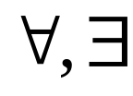
谓词逻辑的基本概念
定义：在谓词公式 和 中， 后面所跟的 x 叫做量词的指导变项，A 为相应量词的辖域，在辖域 x 中的一切出现称为约束出现（x 被相应量词中的指导变项所约束），A 中不是约束出现的其他变项的出现称为自由出现。
可把自由出现的变项看作谓词公式中的参数。
北京邮电大学 计算机学院 离散数学

Slide 40
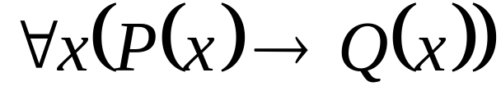
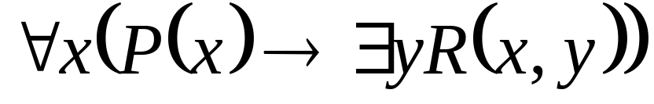
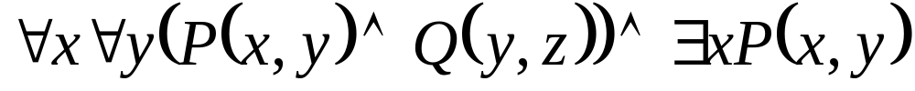
例子
例：指出下式的辖域与变项约束出现的情况。
(1)
(2)
(3)
北京邮电大学 计算机学院 离散数学

Slide 41
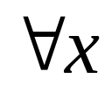
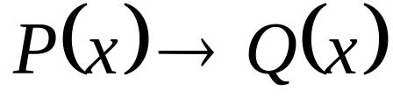
例子
例：指出下式的辖域与变项约束出现的情况。
(1)
解：(1) 的辖域为 ，x 为指导变项， x 为约束出现。
北京邮电大学 计算机学院 离散数学

Slide 42
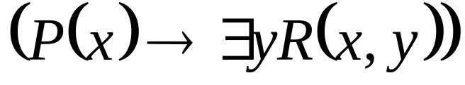
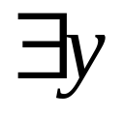
例子
例：指出下式的辖域与变项约束出现的情况。
(2)
解：(2) 的辖域为 ，x 为指导变项， 的辖域为 R(x, y)，y 为指导变项， x ，y 为约束出现。
北京邮电大学 计算机学院 离散数学

Slide 43
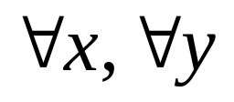
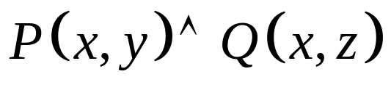

例子
例：指出下式的辖域与变项约束出现的情况。
(3)
解：(3) 的辖域都是 ，
x ，y 为指导变项 ， x ，y 约束出现， z 自由出现，
的辖域为P( x , y )， x 为指导变项， x 约束出现， y 是自由出现，在整个公式中， x是约束出现， y 既是约束出现又是自由出现， z 是自由出现。
北京邮电大学 计算机学院 离散数学

Slide 44
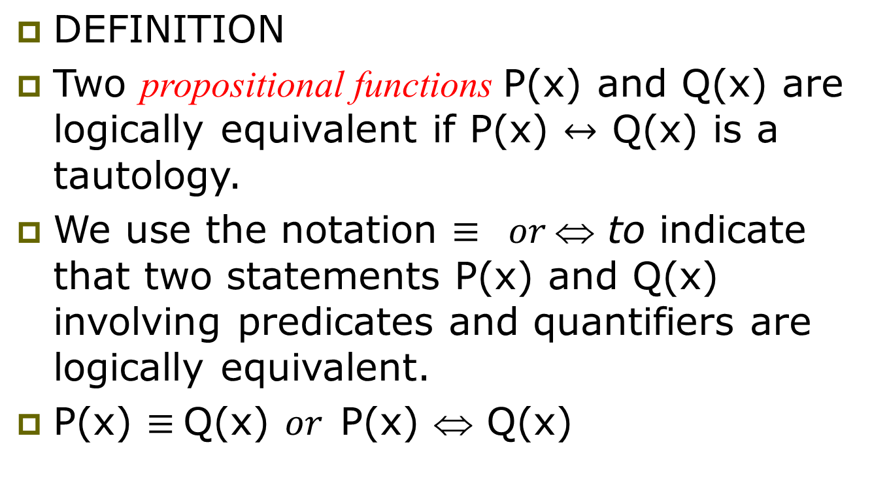
Logical Equivalences Involving Quantifiers

Slide 45
Example 19
Show that ∀x(P(x) ∧ Q(x) ) ⇔ ∀xP(x) ∧ ∀xQ(x)
Proof: First, we show that if ∀x(P(x) ∧ Q(x) ) is true, then ∀xP(x) ∧ ∀xQ(x) is true.
Second, we show that if ∀xP(x) ∧ ∀xQ(x) is true, then ∀x(P(x) ∧ Q(x) ) is true .

Slide 46
Example 19
Show that ∀x(P(x) ∧ Q(x) ) ⇔ ∀xP(x) ∧ ∀xQ(x)
Proof: So, suppose that ∀x(P(x) ∧ Q(x) ) is true. This means that if a is in the domain, then P(a) ∧ Q(a) is true. Hence, P(a) is true and Q(a) is true.
Because P(a) is true and Q(a) is true for every element in the domain, we can conclude that ∀x P(x) and ∀x Q(x) are both true.
This means that ∀xP(x) ∧ ∀xQ(x) is true.

Slide 47
Example 19
Show that ∀x(P(x) ∧ Q(x) ) ⇔ ∀xP(x) ∧ ∀xQ(x)
Proof: Next, suppose that ∀xP(x) ∧ ∀xQ(x) is true. It follows that ∀xP(x) is true and ∀xQ(x) is true.
Hence, if a is in the domain, then P(a ) is true and Q(a) is true.
it follows that for all a, P(a) ∧ Q(a) is true, so
∀x(P(x) ∧ Q(x) ) .

Slide 48
Generalized De Morgan’s laws for Logic
If P(x) is a propositional function, then each pair of propositions in a) and b) below have the same truth values:
a) ~(∀x P(x)) and ∃x: ~P(x)
"It is not true that for every x, P(x) holds" is equivalent to "There exists an x for which P(x) is not true"
b) ~(∃x P(x)) and ∀x: ~P(x)
"It is not true that there exists an x for which P(x) is true" is equivalent to "For all x, P(x) is not true"

Slide 49
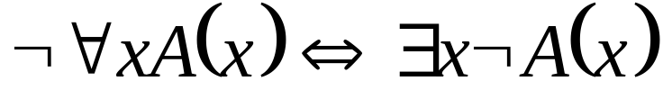
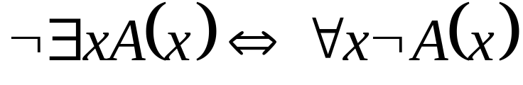
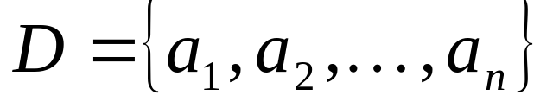
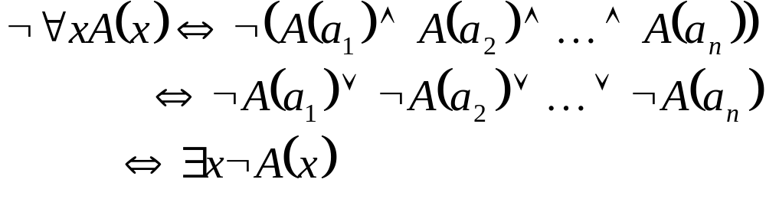
谓词演算中的等值式
定理1 量词否定等值式
(1)
(2)
Complete proof look at p46
当个体域 ，证明如下：
北京邮电大学 计算机学院 离散数学

Slide 50
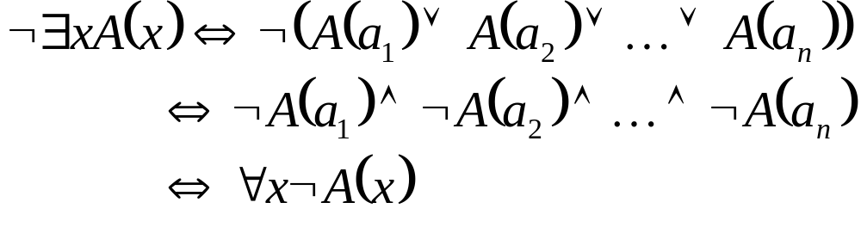
定理1 量词否定等值式
(1)
(2)
当个体域 ，证明如下：
北京邮电大学 计算机学院 离散数学

Slide 51
Example 20
What are the negation of the statements “there is an honest politician”
存在一个诚实的政治家 的否定
不存在一个诚实的政治家
“there is NOT an honest politician”
Every politician is dishonest
(BUT
All politicians are NOT honest = NOT all politicians are honest )
College of Computer Science & Technology, BUPT

Slide 52
Example 20
What are the negation of the statements “All Americans eat cheeseburgers”?
所有的美国人都吃吉士汉堡 的否定
并非所有的美国人都吃吉士汉堡
NOT all Americans eat cheeseburgers
There is an American who does not eat cheeseburgers
OR Some American does not eat cheeseburgers
College of Computer Science & Technology, BUPT

Slide 53
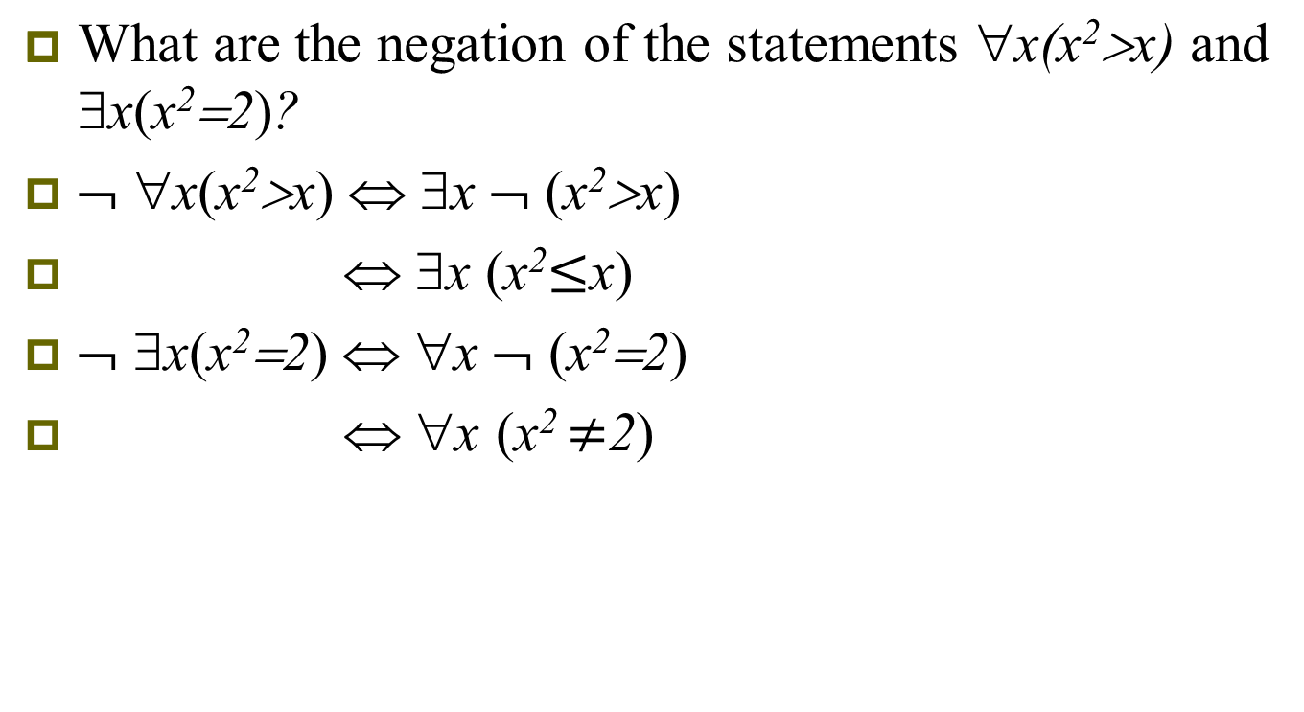
Example 21
College of Computer Science & Technology, BUPT

Slide 54
Translating from English into Logical Expressions
Translating sentences in English (or other natural languages) into logical expressions is a crucial task.
Translating from English to logical expressions becomes even more complex when quantifiers are needed.
There can be many ways to translate a particular sentence.

Slide 55
例子——谓词符号化
例：(1) 所有的人都是要呼吸的
(2) 有的人早饭吃面包
在谓词逻辑中符号化，在考虑符号化之前必须明确个体域。
北京邮电大学 计算机学院 离散数学

Slide 56
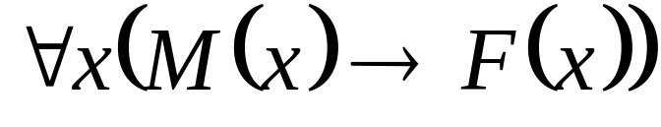
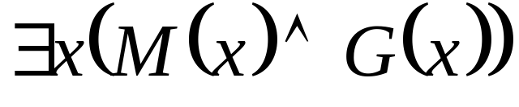
例子
解：在全总个体域的情况下，两命题可叙述为：(1) 对所有的个体，假如它是人，则它是要呼吸的。(2) 存在着个体，它是人并且早饭吃面包。
必须引入新的谓词M(x) : x 是人。M(x)特性谓词。
(1)
(2)
北京邮电大学 计算机学院 离散数学

Slide 57
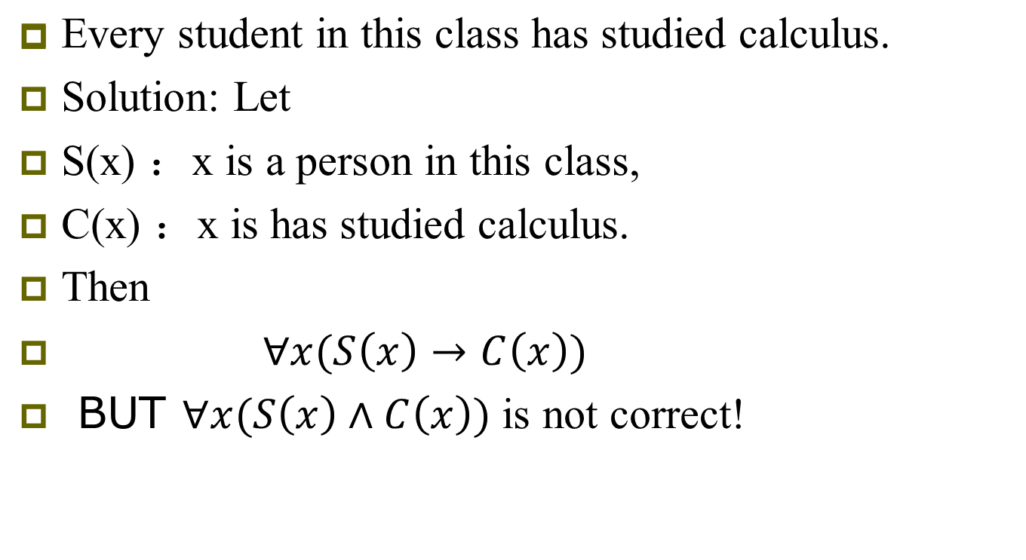
Example 23
College of Computer Science & Technology, BUPT

Slide 58
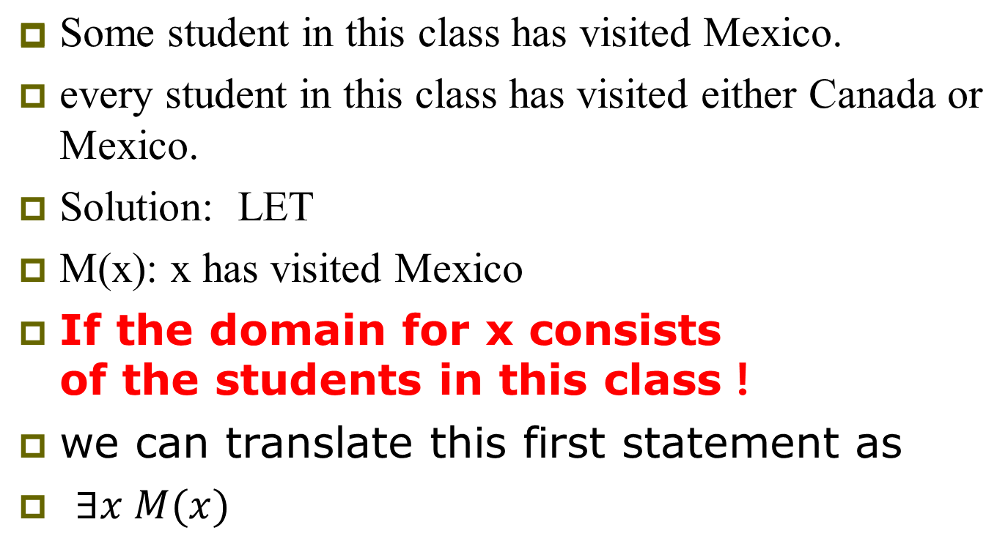
Example 24
College of Computer Science & Technology, BUPT

Slide 59
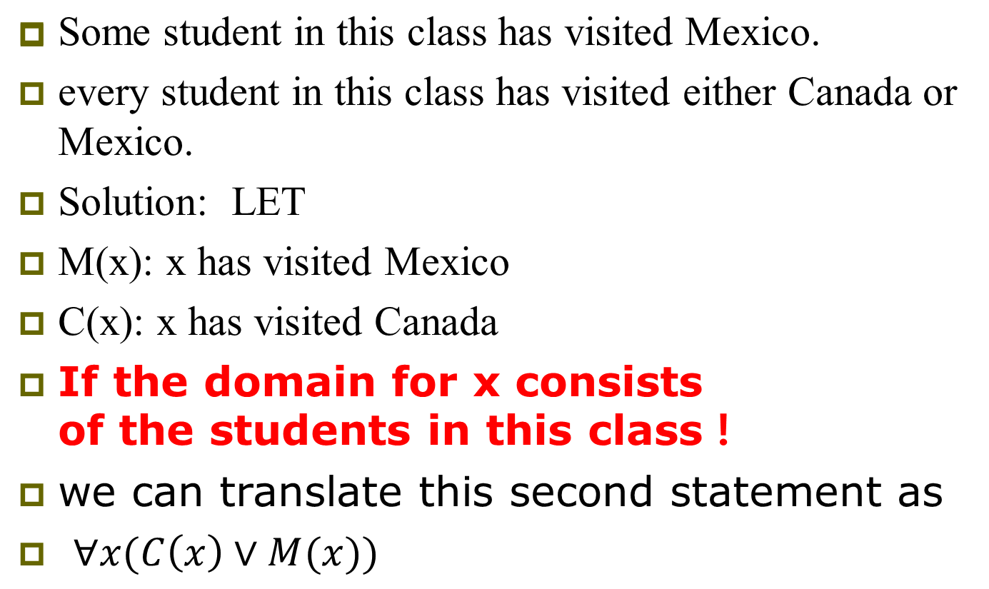
Example 24
College of Computer Science & Technology, BUPT

Slide 60
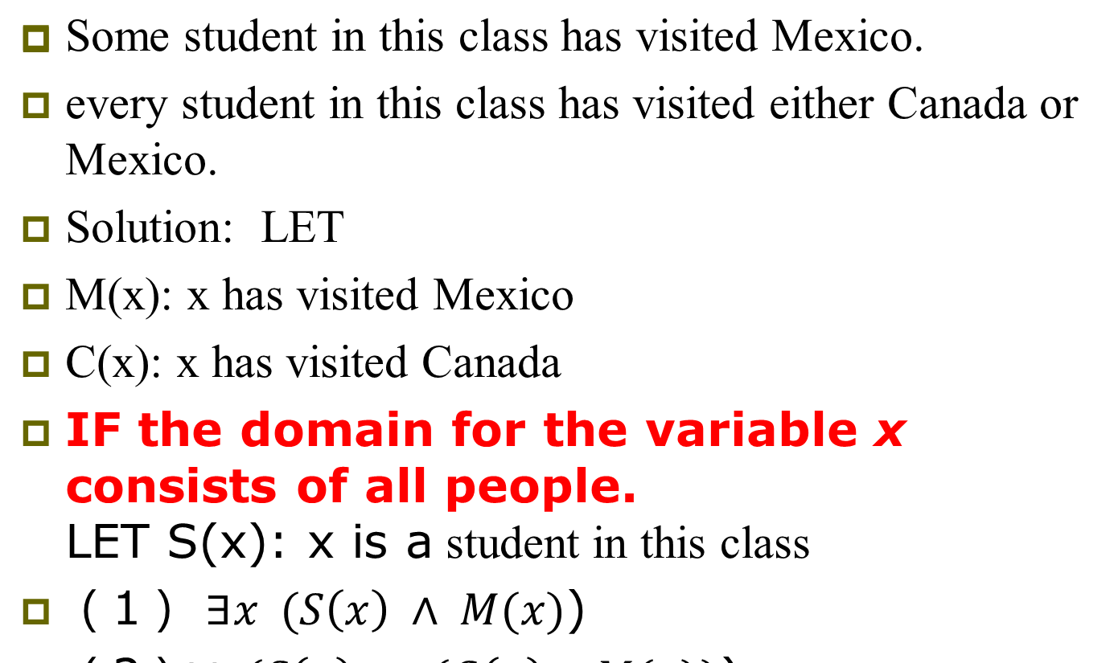
Example 24
College of Computer Science & Technology, BUPT

Slide 61
Example 26
(1) All lions are fierce.
(2) Some lions do not drink coffee.
(3) Some fierce creatures do not drink coffee.
Solution: Let
P(x): x is a lion
Q(x): x is fierce creature
R(x): x drinks coffee
(1) ∀ x ( P(x) → Q(x) )
College of Computer Science & Technology, BUPT

Slide 62
Example 26
(1) All lions are fierce.
(2) Some lions do not drink coffee.
(3) Some fierce creatures do not drink coffee.
Solution: Let
P(x): x is a lion
Q(x): x is fierce creature
R(x): x drinks coffee
(2) ∃ x ( P(x) ∧ ¬ R(x) )
College of Computer Science & Technology, BUPT

Slide 63
Example 26
(1) All lions are fierce.
(2) Some lions do not drink coffee.
(3) Some fierce creatures do not drink coffee.
Solution: Let
P(x): x is a lion
Q(x): x is fierce creature
R(x): x drinks coffee
(3) ∃ x ( Q(x) ∧ ¬ R(x) )
College of Computer Science & Technology, BUPT

Slide 64
Example 27
All hummingbirds(蜂鸟) are richly colored.
No large birds live on honey.
Birds that do not live on honey are dull in color.
Hummingbirds are small.
Solution: Let
P(x): x is a hummingbird
Q(x): x is large
R(x): x lives on honey
S(x): x is richly colored
College of Computer Science & Technology, BUPT

Slide 65
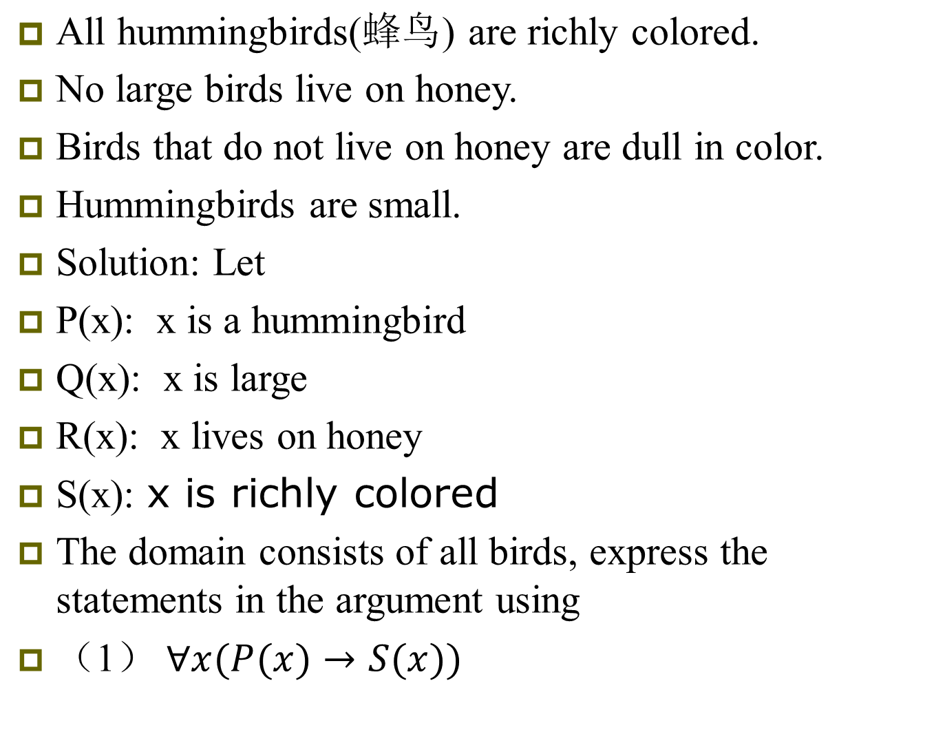
College of Computer Science & Technology, BUPT

Slide 66

College of Computer Science & Technology, BUPT

Slide 67

College of Computer Science & Technology, BUPT

Slide 68

College of Computer Science & Technology, BUPT

Slide 69
Bonus Topic: Logic Programming
There are some programming languages that are based entirely on predicate logic!
The most famous one is called Prolog.
A Prolog program is a set of propositions (“facts”) and (“rules”) in predicate logic.
The input to the program is a “query” proposition.
  Want to know if it is true or false.
The Prolog interpreter does some automated deduction to determine whether the query follows from the facts.
College of Computer Science & Technology, BUPT

Slide 70
Homework
P53
  10,18,36,40,62
College of Computer Science & Technology, BUPT

